Slide 1
Milestone-1
AMR
Assembling the Robile platform
TEAM 3
Dsouza, Arnold [adsouz2s]
Dhakal, Rasna [rdhaka2s]
Victor, Vicky Prince [vvicto2s]
Narayan, Pallavi Aithal [pnaray2s]
Adhikari, Pratik [padhik2s]
George, Salvin [sgeorg2s]

Slide 2

Objectives
Hands-on Experience
Appreciating Modularity
Form of communication with the robot
Understanding the architecture
Collaboration and Teamwork
Notes:
Hands-on Experience: The primary objective of this milestone is to provide hands-on experience in assembling the robot in different configurations. The members could appreciate the modularity of the robot and its flexibility in adapting to different tasks.
Appreciating Modularity: The modular design of the robot allows easy customization and reconfiguration to suit specific tasks. Through this milestone, the members will learn how to assemble the robot in various configurations and understand the importance of modularity.
Form of communication with the robot: Another key objective of this training is to learn various forms of communication with the robot platform. The trainees will learn how to communicate with the robot using programming languages, sensors, actuators, and other tools.
4. Understanding the architecture: Members were able to understand the mechanical and electrical architecture and this further enabled the understanding on the working of the robot
5. Collaboration and Teamwork: Finally, this miletstone fostered collaboration and teamwork among the participants. They will work in groups to assemble and turn on the robot, share knowledge and skills, and learn from each other.

Slide 3

Working as a team
Shared vision
Complete involvement in the assembly
Sharing knowledge
Division of labour
Problem solving
Celebrate Success
Notes:
1, Shared Vision: A successful robot assembly project requires a shared vision among team members. Each team member should have a clear understanding of the project objectives, timeline, and individual responsibilities.
2, Complete involvement in the assembly: While working, each member made sure that the other members are actively participating in the tasks. Each member was a part of each and every single tasks performed and tools used.
3, Sharing knowledge: Being from different backgrounds, the team was able to help each other with different domains enabling the swift transaction of knowledge
4, Division of Labor: Divide the project into manageable tasks and assign each task to team members according to their strengths and interests. This will increase efficiency and reduce the risk of errors or delays.
5, Problem Solving: When problems arise, the team should work together to find solutions. Brainstorming sessions and open discussions can help identify potential solutions, and team members should be willing to compromise and adjust their approach as necessary.
6, Celebrate Success: Finally, celebrate the team's success once the robot is assembled and functional. Recognize individual contributions and the team's collective effort, and take the time to reflect on lessons learned and areas for improvement.

Slide 4

Robile Assembly: Challenges and Solutions
Use of different tools : Productive discussion and Taking help while needed
Understanding the mechanical and electrical assembly: By referring to the video, documentation and instructions from the Teaching Assistant

Slide 5

Overall Approach
Define the milestone scope
Break the milestone into smaller parts
Incorporate hands-on learning
Integrate theory and practice
Encourage collaboration
Provide feedback
Reflect on learning
Notes:
Define the Milestone Scope: Begin by defining the scope of the milestone and its objectives. Consider the overall learning outcomes and what knowledge and skills the milestone should impart to the learners.
Break the Milestone into Smaller Parts: Break the milestone into smaller, manageable parts. This will help learners build on their knowledge and skills gradually and in a structured way.
Incorporate Hands-on Learning: Incorporate hands-on learning opportunities into the milestone. This can include activities such as robot assembly, programming, and testing. Hands-on learning allows learners to apply their knowledge and skills in a real-world context.
Integrate Theory and Practice: Connect the theoretical concepts to practical applications. Use real-world examples and scenarios to help learners understand how the theoretical concepts are relevant to the milestone and to their future learning.
Encourage Collaboration: Encourage learners to work collaboratively on the milestone. This can foster a sense of community and support among learners and allow them to learn from each other's strengths and experiences.
Provide Feedback: Provide feedback to learners throughout the milestone. Feedback should be constructive, specific, and timely, and should help learners improve their performance and understanding.
Reflect on Learning: Encourage learners to reflect on their learning throughout the milestone. This can help them identify areas where they need additional support and where they have made progress. It can also help them set goals for their future learning.

Slide 6
Milestone-2
AMR
Collision Avoidance
TEAM 3
Dsouza, Arnold [adsouz2s]
Dhakal, Rasna [rdhaka2s]
Victor, Vicky Prince [vvicto2s]
Narayan, Pallavi Aithal [pnaray2s]
Adhikari, Pratik [padhik2s]
George, Salvin [sgeorg2s]

Slide 7
Objectives
Implementation of behavior tree to achieve preliminary robot safety features to handle situations such as
1. Battery dropping below a threshold value
2. Avoiding possible collisions
Getting familiar with py-tree, ros and git

Slide 8
Working as a team
Shared vision
Knowledge transfer
Pair programming
Division of labour
Problem solving
Celebrate success

Slide 9
Collision avoidance: Challenges and Solutions
Understanding how py-tree works: Referring to the documentations
Debugging the code: Publishing values to the blackboard to debug

Slide 10

Obstacles
Issue in publishing the battery voltage due to the topic name mismatch.
Reading the laser scan data from the blackboard.
[collison_avoidance-1] File "/opt/ros/foxy/lib/python3.8/site-packages/py_trees/blackboard.py", line 928, in _getattr_[collison_avoidance-1] raise KeyError("client '{}' tried to access '{}' but it does not yet exist on the blackboard".format(self.name, remapped_name)) from e[collison_avoidance-1] KeyError: "client 'laser_scan_2bb' tried to access '/laser_scan' but it does not yet exist on the blackboard"[ERROR] [collison_avoidance-1]: process has died [pid 23780, exit code 1, cmd '/home/ubuntu/colcon_ws_AMR/install/autonomous_map_navigate/lib/autonomous_map_navigate/collison_avoidance --ros-args'].

Slide 11
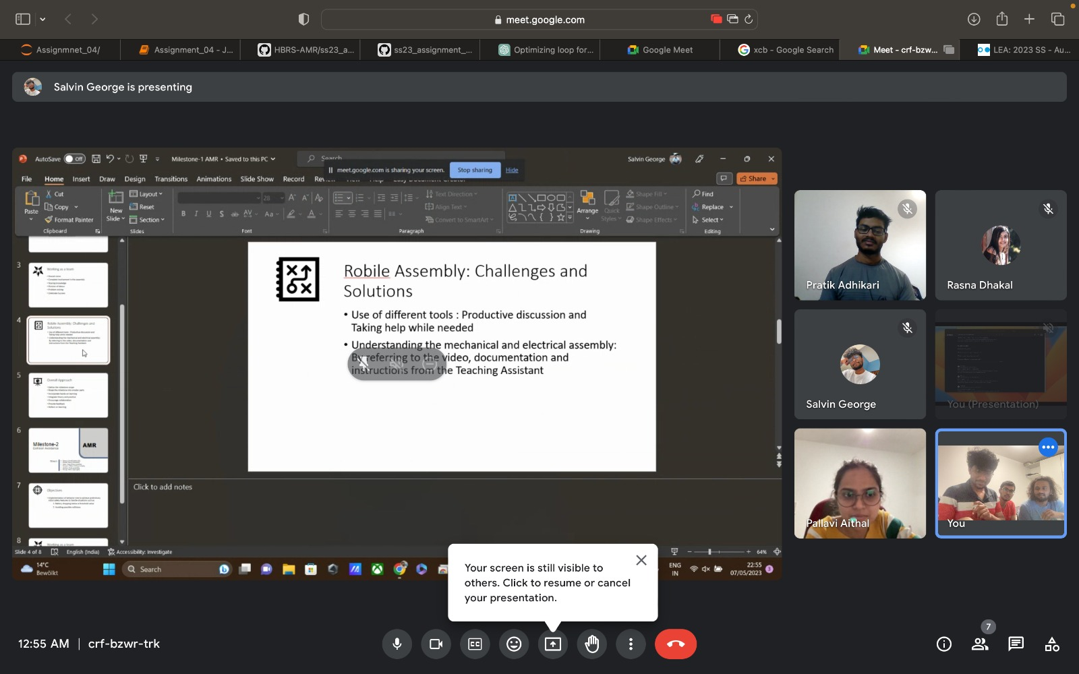
Thank You 🙂

